Slide 1
Road Surface Score Prediction
- Sindhuri Punyamurthula

Slide 2
Goal of the project
Predict the road surface score on a scale of 0 to 4 using deep learning regression models.
Models used
LSTM
CNN-LSTM
SVR

Slide 3
Environment Setup
Jupyter ipython notebook, Python’s sci-kit package, Keras with TensorFlow background and opencv2 were used for models
Matplotlib and OpenCV were used to work with images and plot the graphs during model evaluation.
Bokeh was used for visualization of the results and data along with Google Maps API.
Pandas was used for data manipulation and analysis.
Pandas data frames ensured high-performance
Numpy library was used for scientific computing

Slide 4
Training & Test set details
Garmin Dashcam was used to capture road surface videos with location and timestamp in and around Bay Area ,CA.
Number of training videos : 114
Number of test videos : 52
Each video was divided into 20 frames ( sequence of images)
Histogram of pixel intensities, Histogram of color and the images were used as features.
Mean Absolute Error(MAE) and Root Mean Square Error (RMSE) were used as evaluation metrics
Labels 0 – unrelated/unclear roads, 1 – new/unworn roads, 2 – slightly worn, 3 – worn, 4 – heavily worn roads

Slide 5
Preprocessing Data
Scores were given to each video based on the road surface conditions for both test and training data
A python tool was developed which takes saved road videos as input and splits them into 20 images or frames
All videos with number of frames less than 20 were skipped/ignored
Two types of histograms with 16 bins and 10 bins were used in the LSTM and SVR related models
Each histogram bin value was divided by the maximum bin value thereby transforming features to a given range

Slide 6
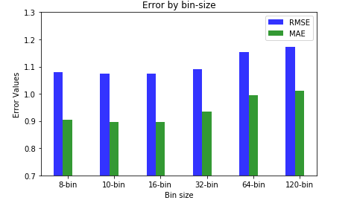
Scenario 1 Features :Histogram of pixel intensities Model Name : LSTM
A comparison of LSTM on histogram of pixels with different bin sizes
Best bin size : 16-bins
No. of LSTM hidden neurons: 100

Slide 7
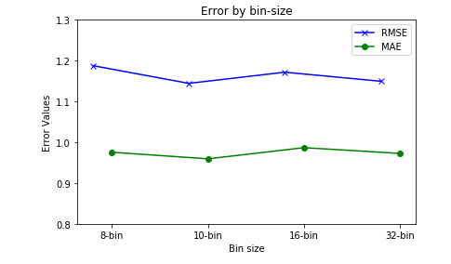
Scenario 2 Features :Histogram of color (RGB) Model Name : LSTM
A comparison of LSTM on histogram of color with different bin sizes
Best bin size : 10-bins
No. of LSTM hidden neurons: 100

Slide 8
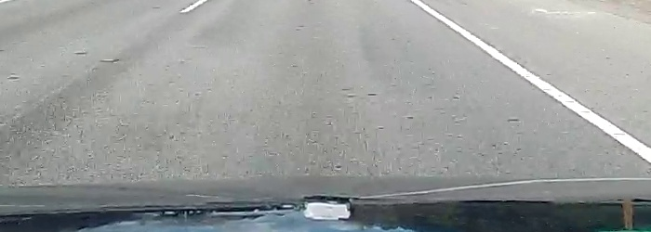
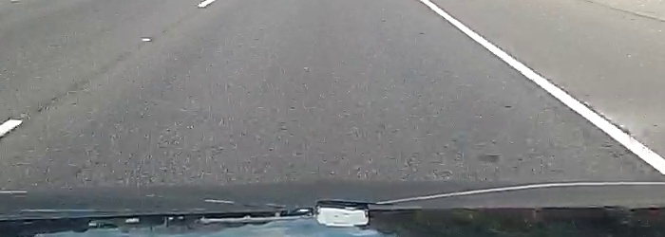
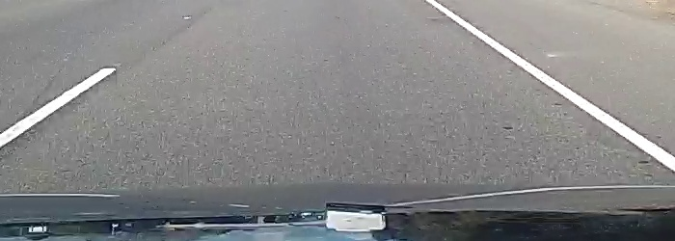
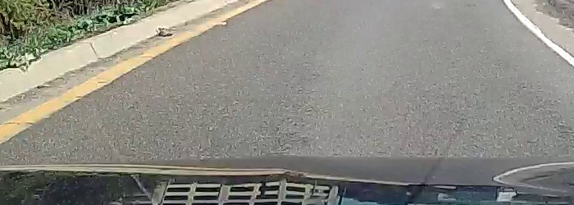
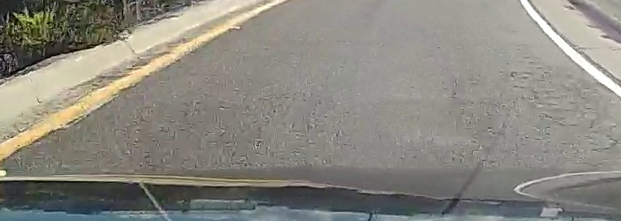
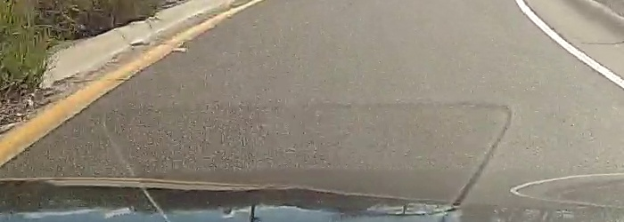
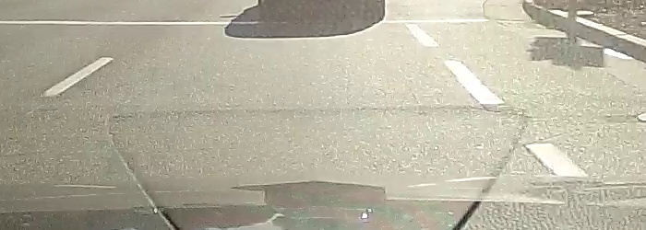
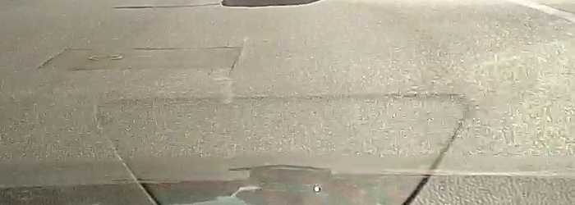
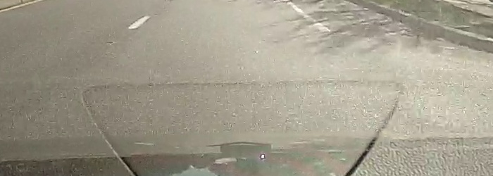
Scenario 3 Features :Image sequences Model Name : CNN-LSTM
INPUT
Video 1 images
OUTPUT
Video 2 images
CNN
LSTM
Score (0-4)
Video 3 images

Slide 9
Scenario 4 Features :Hist. of pixel and Hist. of color Model Name : Support Vector Regression(SVR)
A comparison was made between SVR with histogram of pixels ( 16 bin) and SVR with histogram of color ( 10 bin).
Best Model was SVR with histogram of pixels ( 16 bins).
A GridSearchCV was performed to find the best parameters.
The best parameters were :- C value : 1 ,gamma value : 1 and kernel value: poly

Slide 10
Scenario 5 Features :Hist. of pixel and Hist. of color Model Name : Bidirectional LSTM
Two sequences were used for training. First input sequence was used as is and second was a reversed copy of the initial (first) input sequence
A comparison was made between Bi-LSTM with histogram of pixels ( 16 bin) and Bi-LSTM with histogram of color ( 10 bin).
Best Model was Bi-LSTM with histogram of pixels ( 16 bins).
Sum and concat were two different merge modes used
The best merge mode was ‘sum’.
Layer 1 : 100 LSTM neurons , Layer 2 : 50 LSTM neurons.

Slide 11
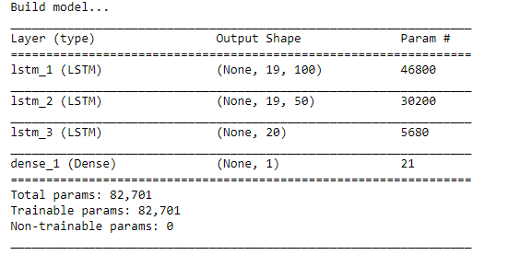
Scenario 6 Features :Hist. of pixel and Hist. of color Model Name : Stacked LSTM
This architecture consists of multiple hidden LSTM layers where each layer has multiple memory cells.
A comparison was made between Stacked-LSTM with histogram of pixels ( 16 bin) and Stacked-LSTM with histogram of color ( 10 bin).
Best Model : Stacked-LSTM with histogram of color ( 10 bins).
Layer 1 : 100 LSTM neurons
Layer 2 : 50 LSTM neurons
Layer 3 : 20 LSTM neurons.

Slide 12
Comparison of results all scenarios Best Model : LSTM with Histogram of pixel values (16 bins)
Model Number | Scenario / Model | RMSE | MAE
M1 | LSTM with Hist. of pixel (16 bins) | 1.0750651787768335 | 0.8969300022492042
M2 | LSTM with Hist. of color (10 bins) | 1.1443335035447977 | 0.9593815402342722
M3 | CNN-LSTM (image sequences) | 1.2542117384007916 | 1.0824612929270818
M4 | SVR with Hist. of pixel (16 bins) | 1.2099404971325132 | 0.9911895095714871
M5 | Bidirectional LSTM with Hist. of pixel (16 bin) | 1.122355363398591 | 0.9546054349495814
M6 | Stacked LSTM with Hist. of color (10 bin) | 1.1210850170107183 | 0.9426209605657138
For all the models 114 training videos and 52 test videos were used.

Slide 13
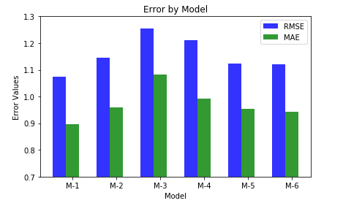
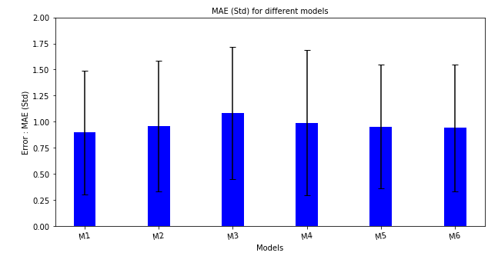
Results of different scenarios

Slide 14
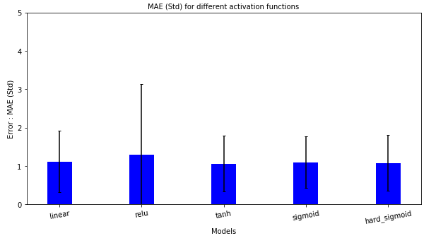
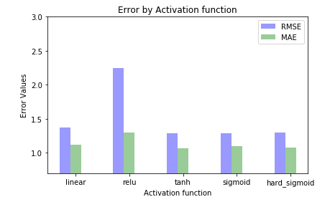
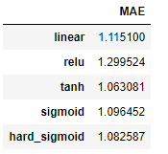
Effect of Activation function on MAE Model :LSTM on hist. of pixels ( 16 bins) Best Activation functions : tanh,sigmoid and hard sigmoid

Slide 15
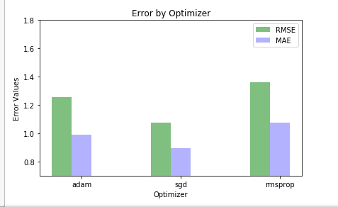
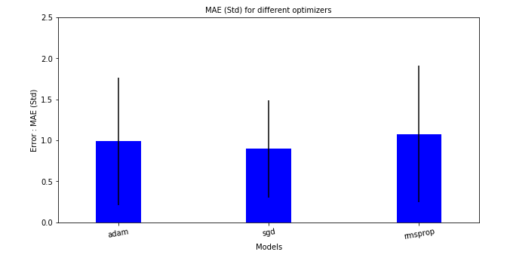
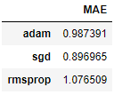
Effect of Optimizers on MAE Model :LSTM on hist. of pixels ( 16 bins) Best Optimizer : sgd

Slide 16
Best Model : LSTM on Hist. of pixel (16 bins)
Training Set consisted of 114 videos.
Test Set consisted of 52 videos.
Each video was split into 20 frames or image sequences.
Lstm neurons : 100
Optimizer function : sgd
Train | Test
0.95 MSE | 1.16 MSE
0.97 RMSE | 1.08 RMSE
0.74 MAE | 0.89 MAE

Slide 17
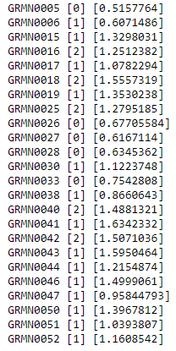
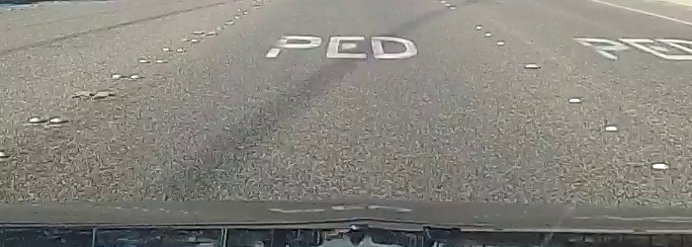
Success Cases
Video Gt Pred
24 videos were successfully predicted out of 52.
Here difference (prediction – ground truth) < 0.8
Example : GRMN0025 image (slightly worn road with score 2)

Slide 18
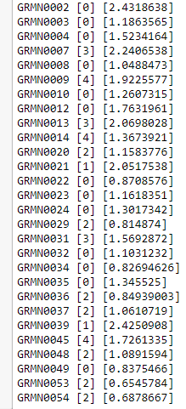
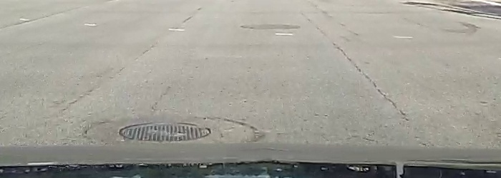
Failed Cases
Video Gt Pred
28 videos were unsuccessfully predicted out of 52.
Here difference (prediction – ground truth) >= 0.8
Example : GRMN0007 image (Worn road with score 3)

Slide 19
Success Cases
A Few Examples where the model predicted successfully are shown in the following slides.

Slide 20
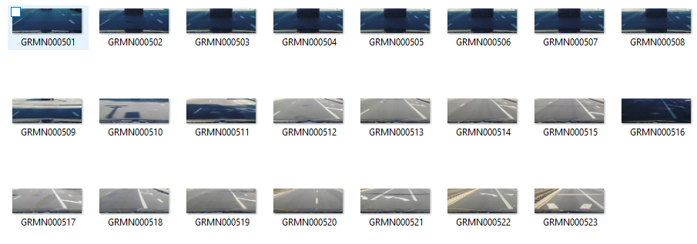
Success Cases
Video Name : GRMN005
Ground Truth : 0
Predicted : 0.51
Since the first few images in
the video are not so clear ,
the ground truth value was
Given as 0.

Slide 21
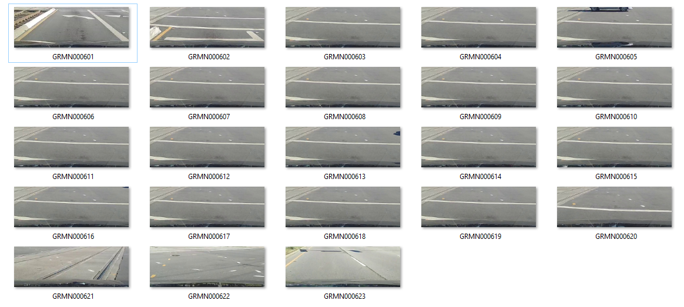
Success Cases
Video Name : GRMN006
Ground Truth : 1
Predicted : 0.61

Slide 22
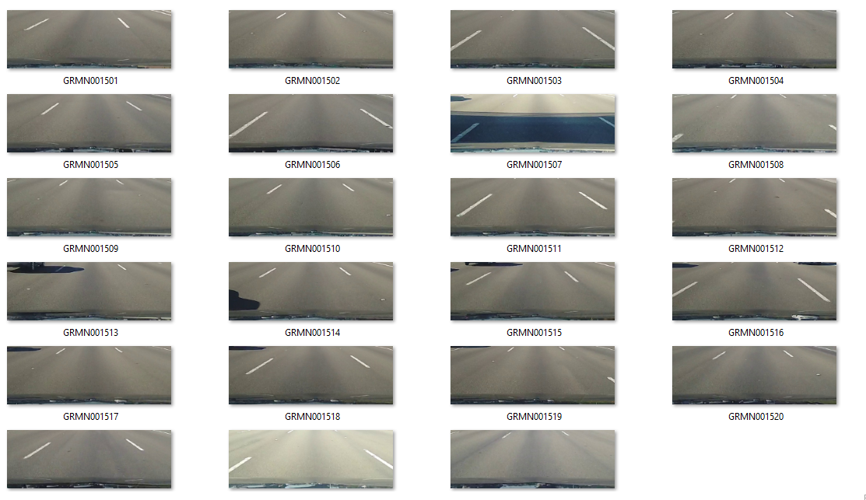
Success Cases
Video Name : GRMN0015
Ground Truth : 1
Predicted : 1.32

Slide 23
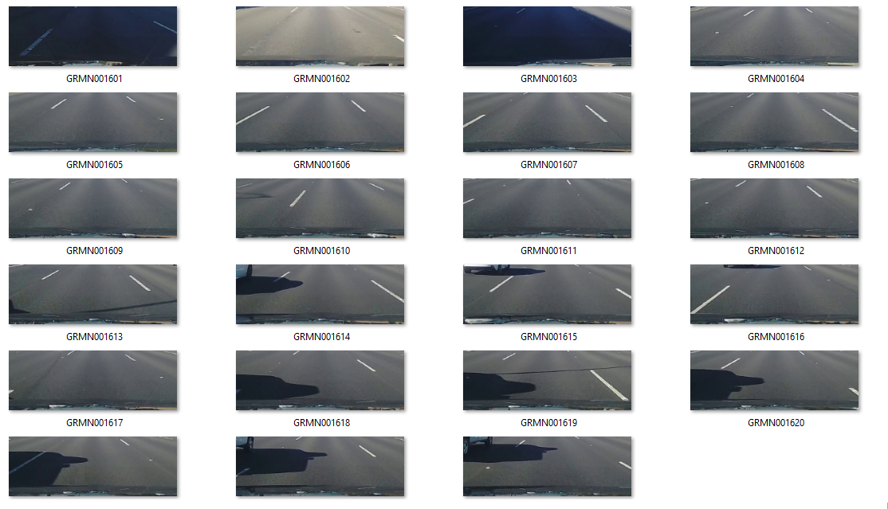
Success Cases
Video Name : GRMN0016
Ground Truth : 2
Predicted : 1.3

Slide 24
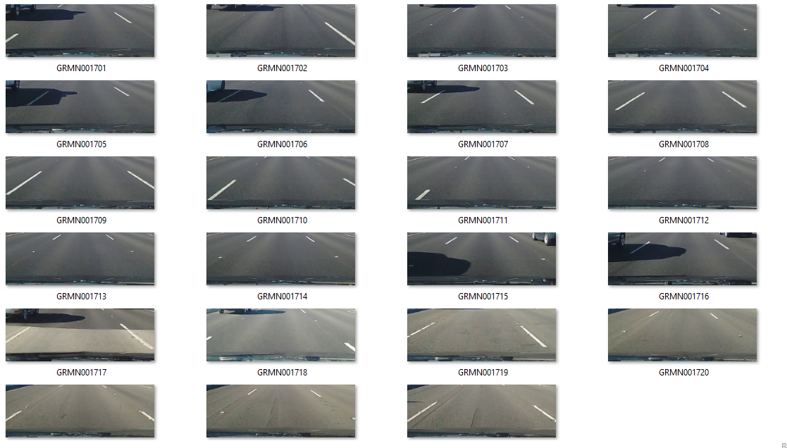
Success Cases
Video Name : GRMN0017
Ground Truth : 1
Predicted : 1.07

Slide 25
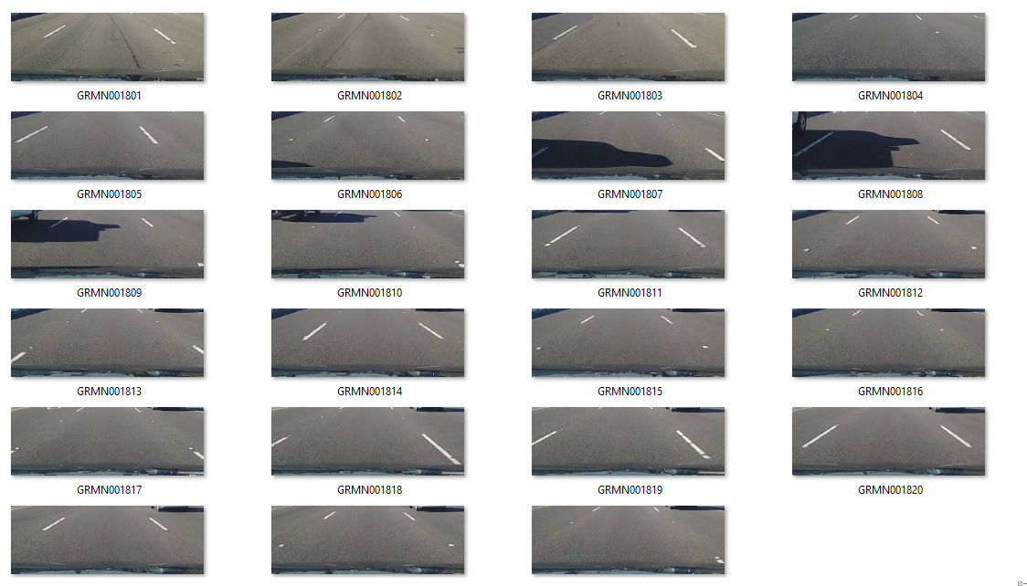
Success Cases
Video Name : GRMN0018
Ground Truth : 2
Predicted : 1.6

Slide 26
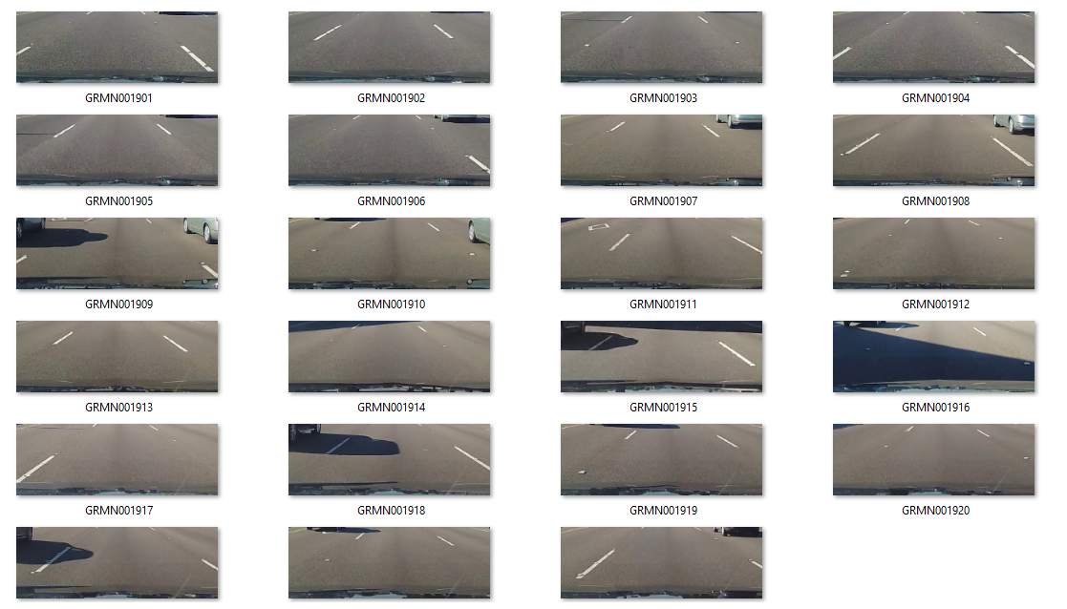
Success Cases
Video Name : GRMN0019
Ground Truth : 1
Predicted : 1.3

Slide 27
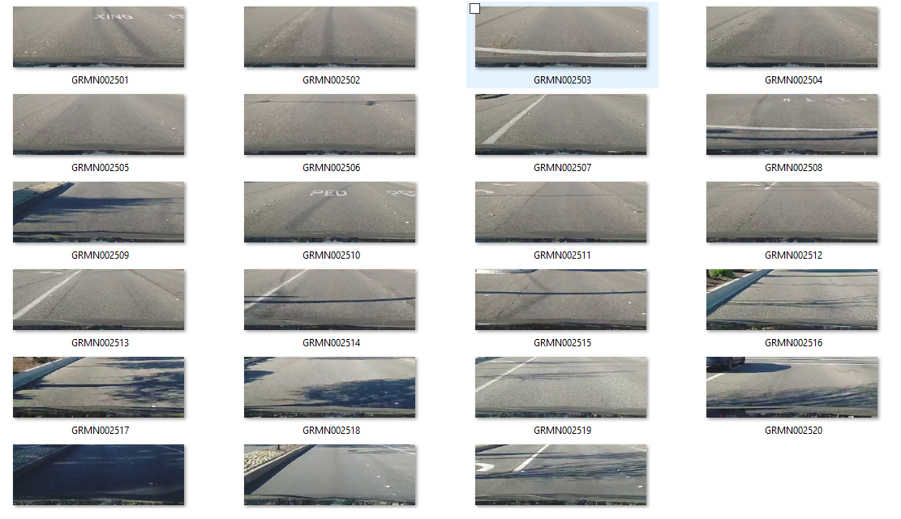
Success Cases
Video Name : GRMN0025
Ground Truth : 2
Predicted : 1.3

Slide 28
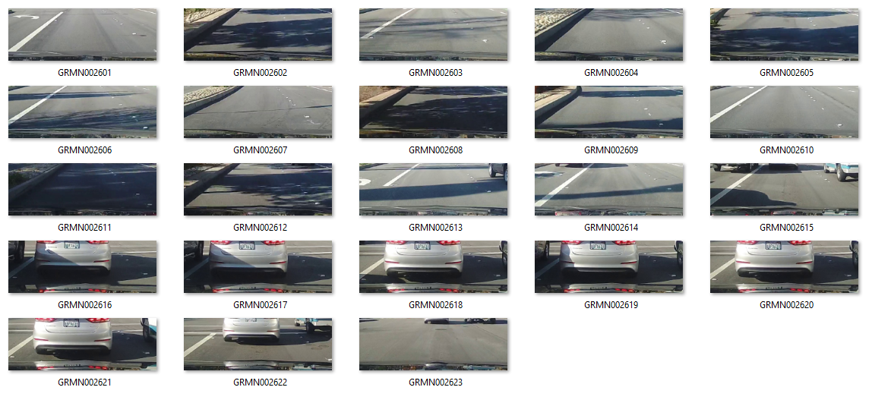
Success Cases
Video Name : GRMN0026
Ground Truth : 0
Predicted : 0.6
Video has many unrelated
Images.

Slide 29
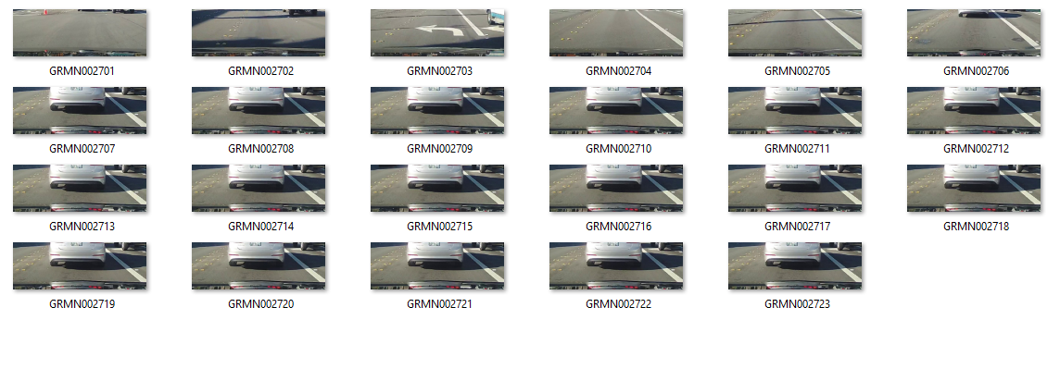
Success Cases
Video Name : GRMN0027
Ground Truth : 0
Predicted : 0.6
Video has unrelated images

Slide 30
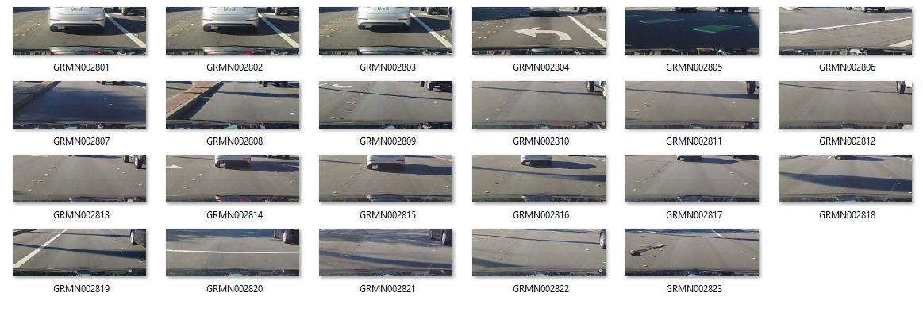
Success Cases
Video Name : GRMN0028
Ground Truth : 0
Predicted : 0.6
Video has unrelated images

Slide 31
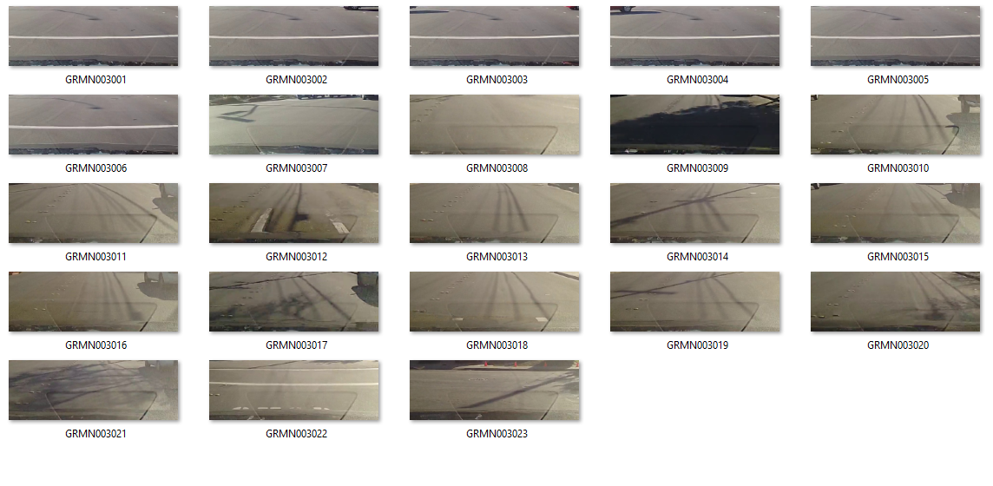
Success Cases
Video Name : GRMN0030
Ground Truth : 1
Predicted : 1.12

Slide 32
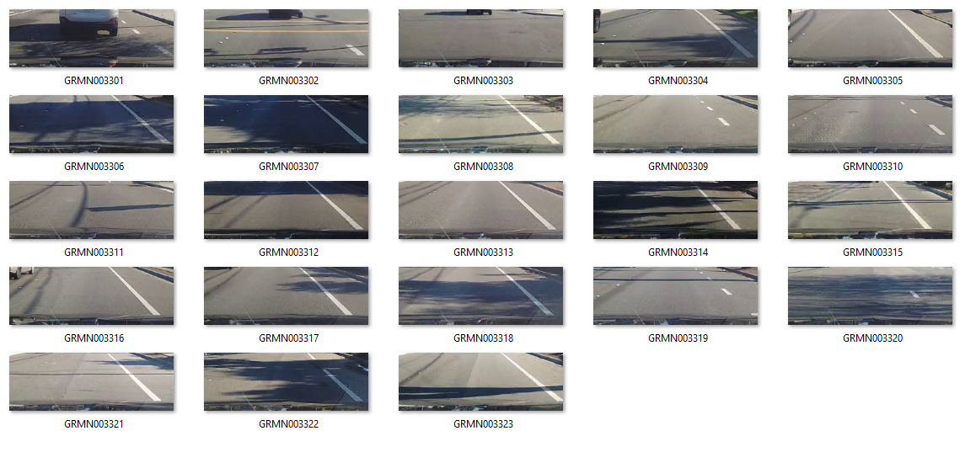
Success Cases
Video Name : GRMN0033
Ground Truth : 0
Predicted : 0.7

Slide 33
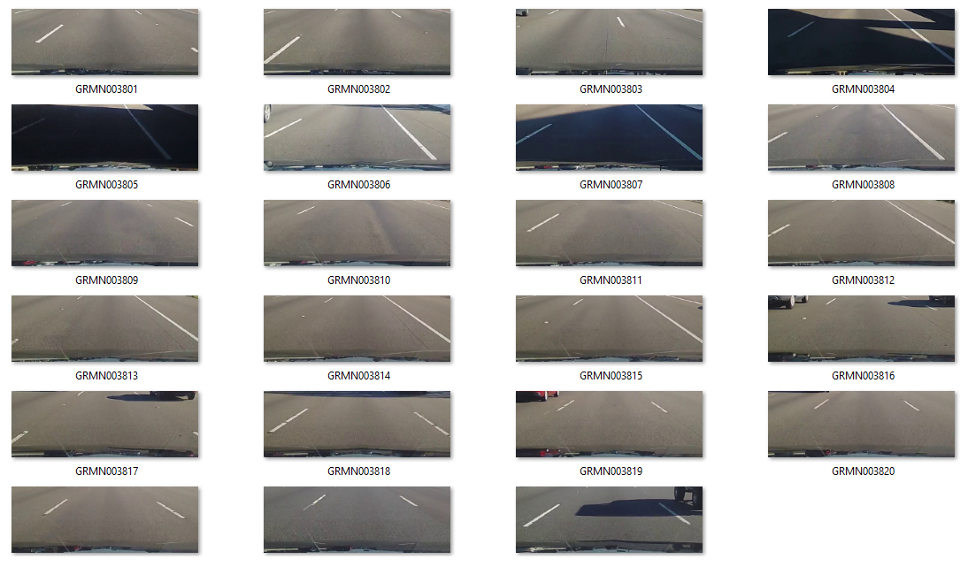
Success Cases
Video Name : GRMN0038
Ground Truth : 1
Predicted : 0.9

Slide 34
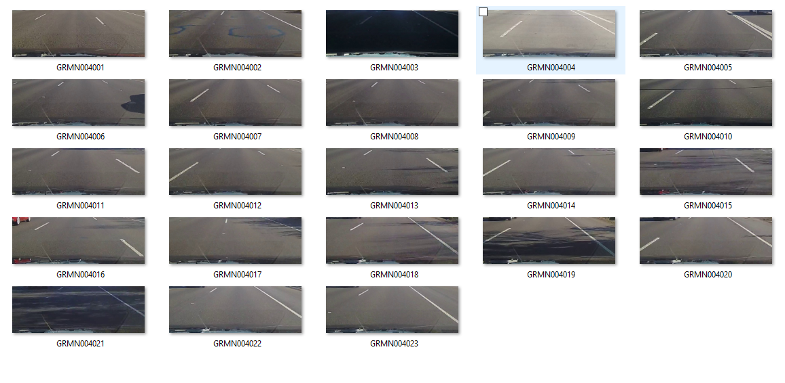
Success Cases
Video Name : GRMN0040
Ground Truth : 2
Predicted : 1.5

Slide 35
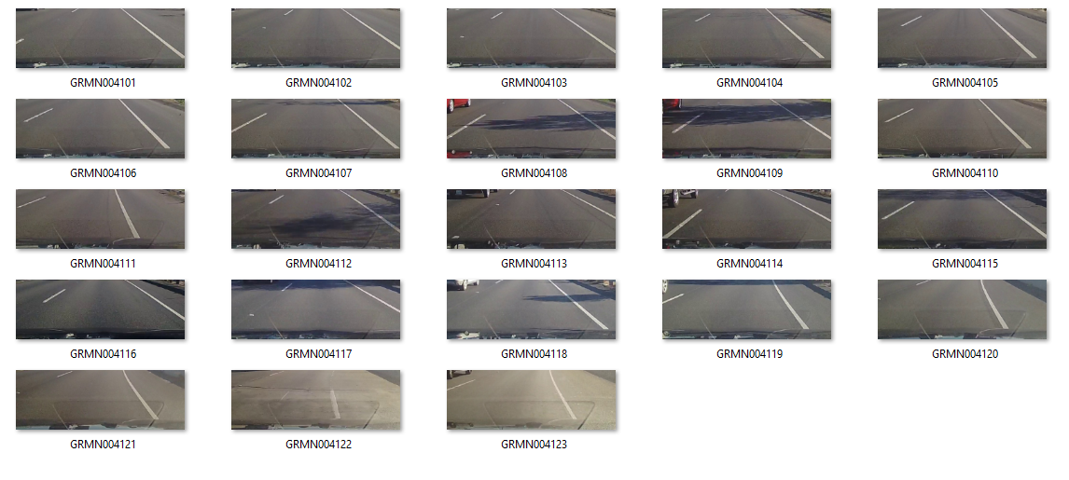
Success Cases
Video Name : GRMN0041
Ground Truth : 1
Predicted : 1.6

Slide 36
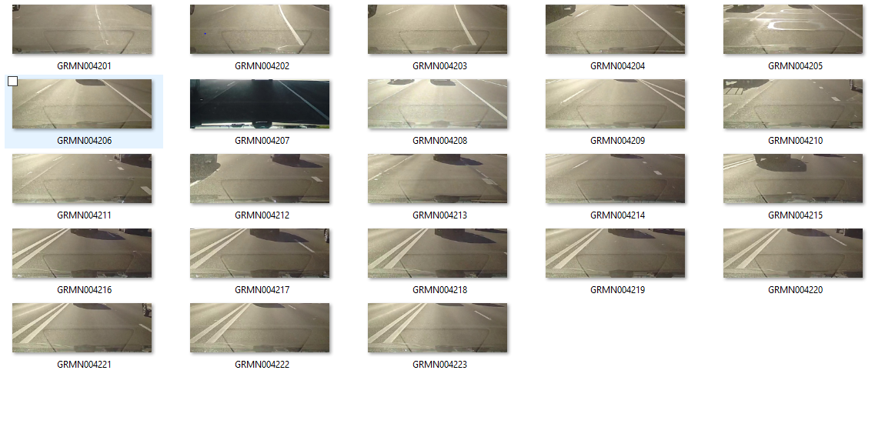
Success Cases
Video Name : GRMN0042
Ground Truth : 2
Predicted : 1.5

Slide 37
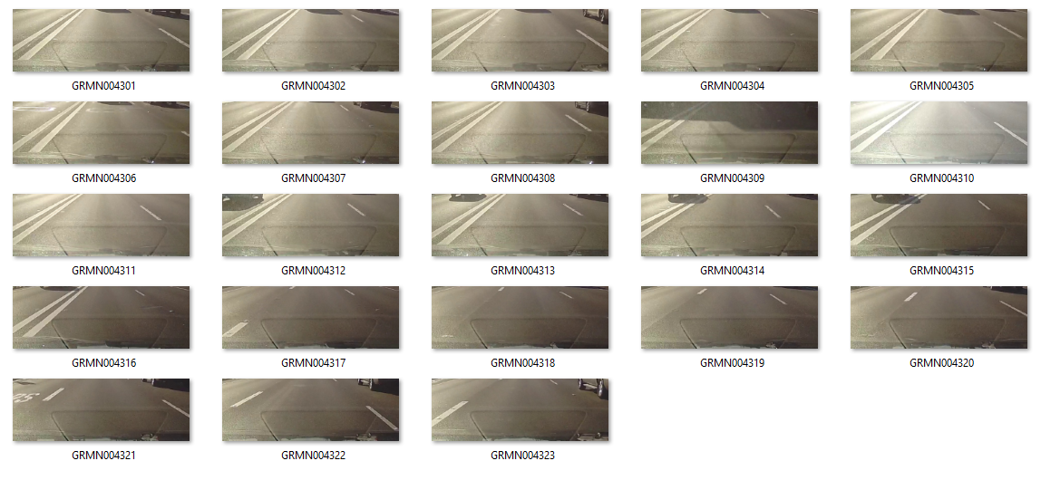
Success Cases
Video Name : GRMN0043
Ground Truth : 1
Predicted : 1.6

Slide 38
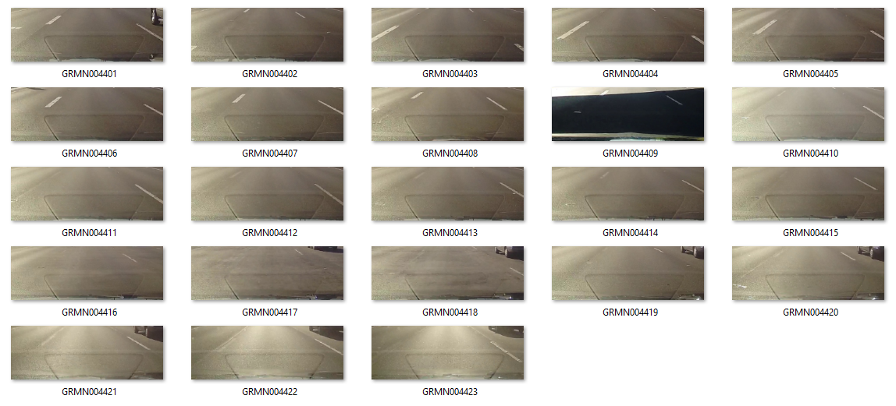
Success Cases
Video Name : GRMN0044
Ground Truth : 1
Predicted : 1.2

Slide 39
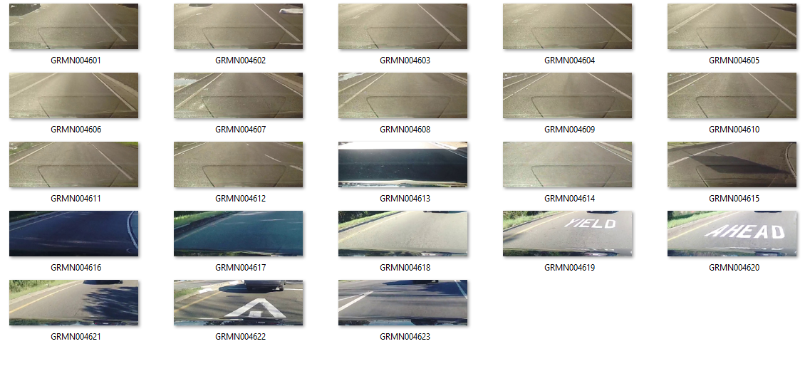
Success Cases
Video Name : GRMN0046
Ground Truth : 1
Predicted : 1.4

Slide 40
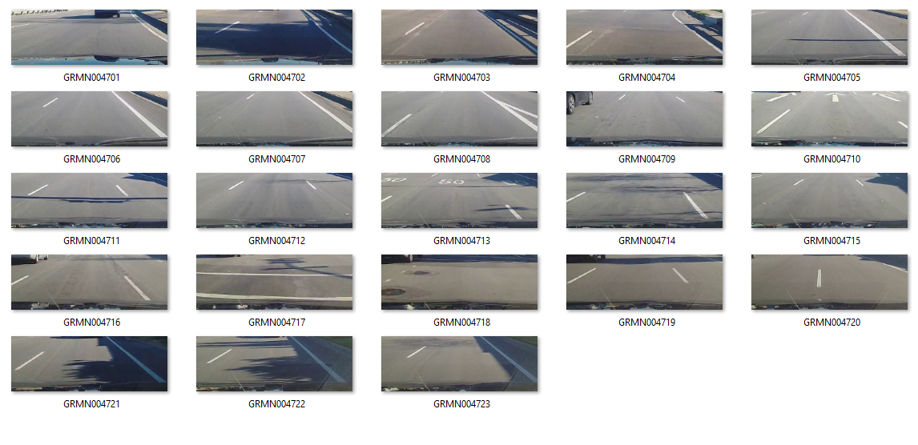
Success Cases
Video Name : GRMN0047
Ground Truth : 1
Predicted : 0.96

Slide 41
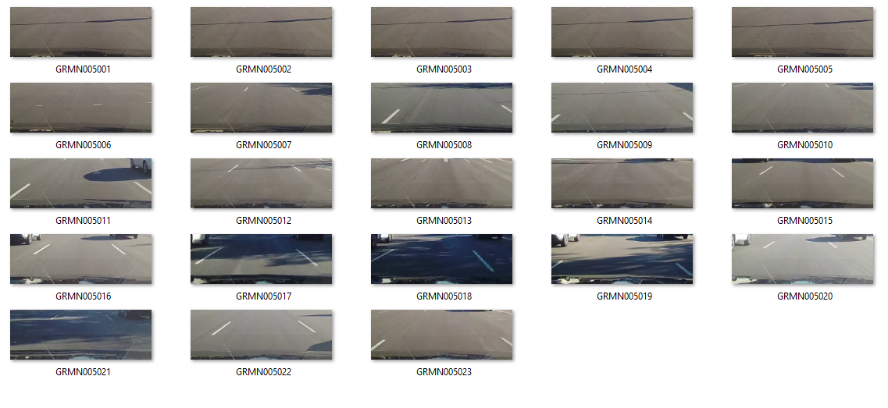
Success Cases
Video Name : GRMN0050
Ground Truth : 1
Predicted : 1.3

Slide 42
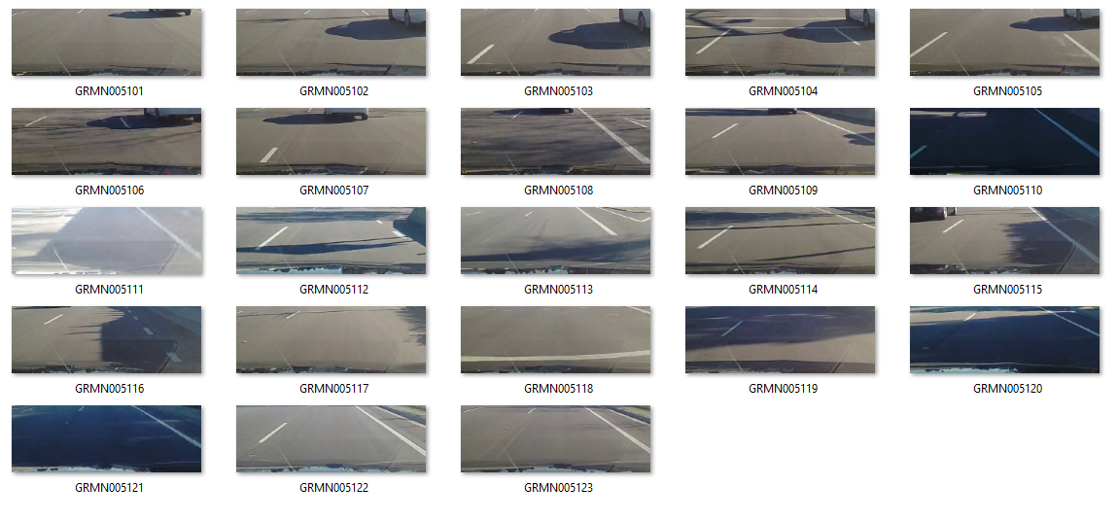
Success Cases
Video Name : GRMN0051
Ground Truth : 1
Predicted : 1.03

Slide 43
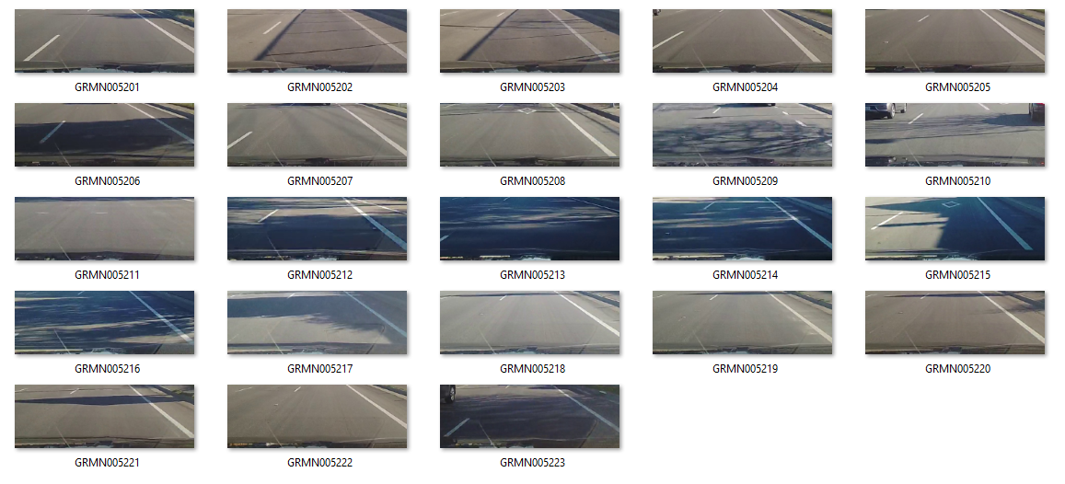
Success Cases
Video Name : GRMN0052
Ground Truth : 1
Predicted : 1.16

Slide 44
Failure Cases
A Few Examples where the model predicted unsuccessfully are shown in the following slides.

Slide 45
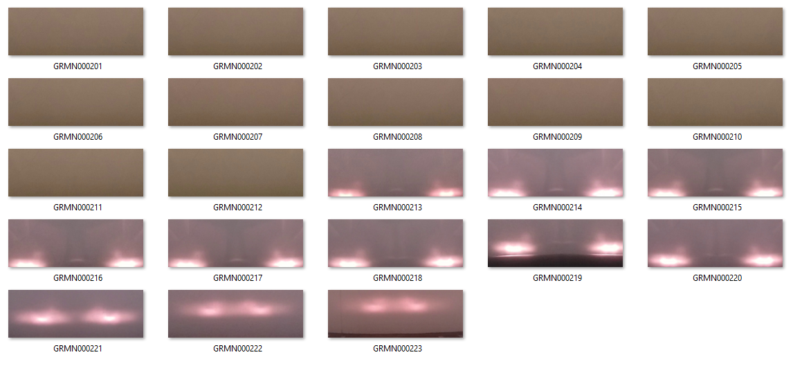
Failure Cases
Video Name : GRMN0002
Ground Truth : 0
Predicted : 2.4

Slide 46
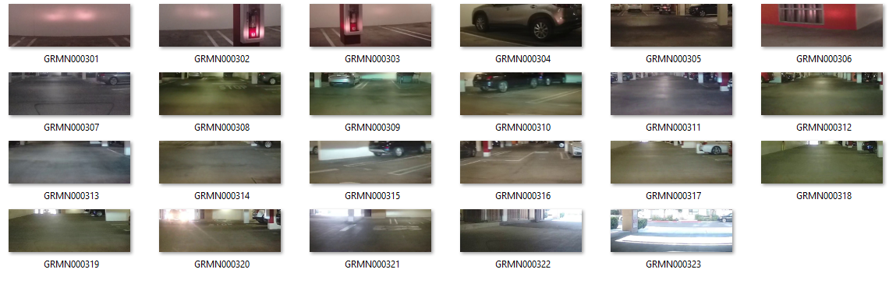
Failure Cases
Video Name : GRMN0003
Ground Truth : 0
Predicted : 1.18

Slide 47

Failure Cases
Video Name : GRMN0004
Ground Truth : 0
Predicted : 1.5

Slide 48

Failure Cases
Video Name : GRMN0007
Ground Truth : 3
Predicted : 2.2

Slide 49

Failure Cases
Video Name : GRMN0008
Ground Truth : 0
Predicted : 1.04

Slide 50

Failure Cases
Video Name : GRMN0009
Ground Truth : 4
Predicted : 1.9

Slide 51

Failure Cases
Video Name : GRMN0010
Ground Truth : 0
Predicted : 1.2

Slide 52

Failure Cases
Video Name : GRMN0012
Ground Truth : 4
Predicted : 1.7

Slide 53

Failure Cases
Video Name : GRMN0013
Ground Truth : 3
Predicted : 2.06

Slide 54

Failure Cases
Video Name : GRMN0014
Ground Truth : 4
Predicted : 1.36

Slide 55

Failure Cases
Video Name : GRMN0020
Ground Truth : 2
Predicted : 1.15

Slide 56

Failure Cases
Video Name : GRMN0021
Ground Truth : 1
Predicted : 2.05

Slide 57

Failure Cases
Video Name : GRMN0022
Ground Truth : 0
Predicted : 0.9

Slide 58

Failure Cases
Video Name : GRMN0029
Ground Truth : 2
Predicted : 0.8

Slide 59

Failure Cases
Video Name : GRMN0031
Ground Truth : 3
Predicted : 1.6

Slide 60

Failure Cases
Video Name : GRMN0032
Ground Truth : 0
Predicted : 1.1

Slide 61

Failure Cases
Video Name : GRMN0036
Ground Truth : 2
Predicted : 0.85

Slide 62

Failure Cases
Video Name : GRMN0037
Ground Truth : 2
Predicted : 1.06

Slide 63

Failure Cases
Video Name : GRMN0039
Ground Truth : 1
Predicted : 2.4

Slide 64

Failure Cases
Video Name : GRMN0045
Ground Truth : 4
Predicted : 1.72

Slide 65

Failure Cases
Video Name : GRMN0048
Ground Truth : 2
Predicted : 1.08

Slide 66

Failure Cases
Video Name : GRMN0053
Ground Truth : 2
Predicted : 0.65

Slide 67

Failure Cases
Video Name : GRMN0054
Ground Truth : 2
Predicted : 0.69

Slide 68


Visualization of Training Data Set
Unclear
New/Unworn
Slightly Worn
Worn
Heavily Worn
Ground Truth
Predictions

Slide 69


Visualization of Test Data Set
Unclear
New/Unworn
Slightly Worn
Worn
Heavily Worn
Ground Truth
Predictions

Slide 70
Conclusion
The best model with the lowest Mean Absolute Error(MAE-0.89) and Root Mean Square Error (RMSE-1.08) is LSTM on histogram of pixel values of 16 bins.
Few methods which can be implemented to improve current prediction
The model requires more training dataset covering more worn and heavily worn roads
Weather conditions and surroundings also affect the quality of images/videos and hence the model predictions.
More number of frames per video can be considered for more accurate results.
Given the system and time constraints, 20 images per video was implemented in the current model
Powerful and complex models with more layers can be used for more accurate results

Slide 71
Acknowledgements
I would like to thank Prof. Xiaobai Liu, Dept of Computer Science, San Diego State University for giving me this opportunity. His guidance, encouragement and suggestions regarding the project were truly helpful.
I would also like to thank Prof. Shawn Healey, Dept of Computer Science, San Diego State University for his valuable support and suggestions throughout various stages of the project.
References :
https://www.coursera.org/learn/nlp-sequence-models
https://machinelearningmastery.com/category/lstm/
https://keras.io/getting-started/sequential-model-guide/
https://opencv.org/
http://scikit-learn.org/stable/modules/classes.html#module-sklearn.metrics
https://matplotlib.org/tutorials/index.html
https://bokeh.pydata.org/en/latest/docs/user_guide.html

